Slide 1

TEAM MEMBERS
JAI PRASANTH G
KARTHICK E
KEERTHIVASAN M
BALAGANESHAN R

Slide 2

House Rental App using MERN
Explore a cutting-edge house rental app built using the powerful MERN stack - MongoDB, Express.js, React.js, and Node.js. This app offers a seamless experience for both renters and landlords, transforming the way people find and manage their dream homes.

Slide 3
Introduction to the MERN stack
MongoDB
Express.js
React.js
Node.js
A flexible, scalable NoSQL database for storing rental property data.
A fast and minimalist web application framework for Node.js, powering the server-side logic.
A JavaScript library for building the app's modern, responsive user interface.
A JavaScript runtime environment for executing the app's server-side code.

Slide 4
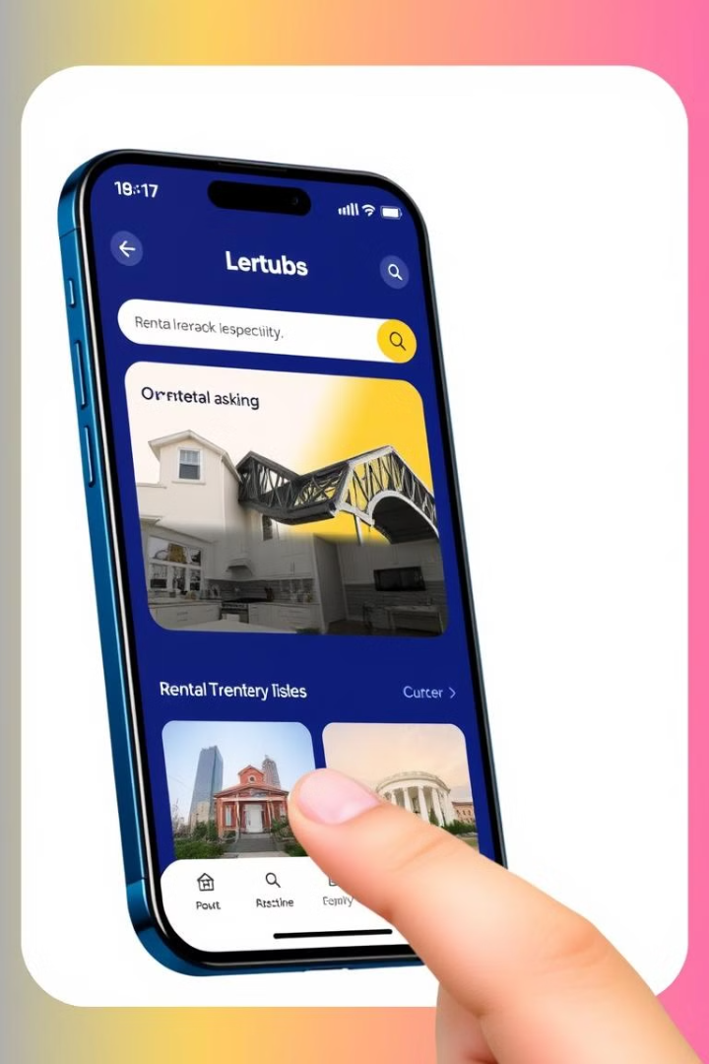
Key Features of the House Rental App
Comprehensive Rental Listings
Advanced Filtering
Easily filter listings by location, price, size, and other key criteria to find the perfect fit.
Browse a wide range of rental properties, from cozy apartments to spacious homes.
Streamlined Booking
Securely book and reserve rental properties with just a few clicks.

Slide 5
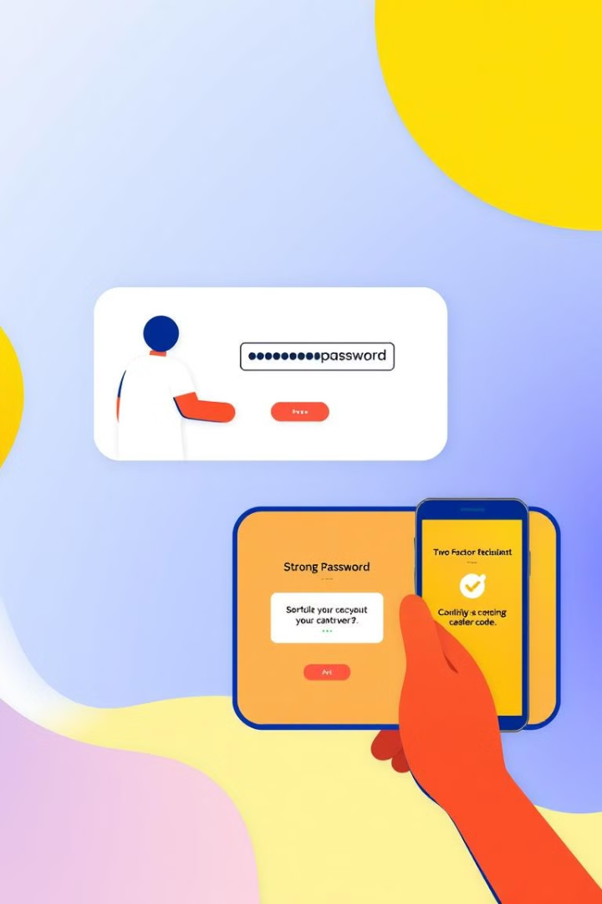
User Registration and Authentication
Secure Sign-Up
User Profiles
Renters and landlords can create accounts with strong password requirements and two-factor authentication.
Users can manage their profiles, update personal information, and view rental history.
Role-Based Access
Renters and landlords have distinct permissions and functionalities within the app.

Slide 6
Searching and Filtering Houses
Geo-Spatial Search
Robust Filtering
Personalized Recommendations
Renters can search for properties based on location, using an interactive map interface.
Advanced filters allow renters to refine their search by parameters like price, size, amenities, and more.
The app suggests rental options based on user preferences and browsing history.

Slide 7
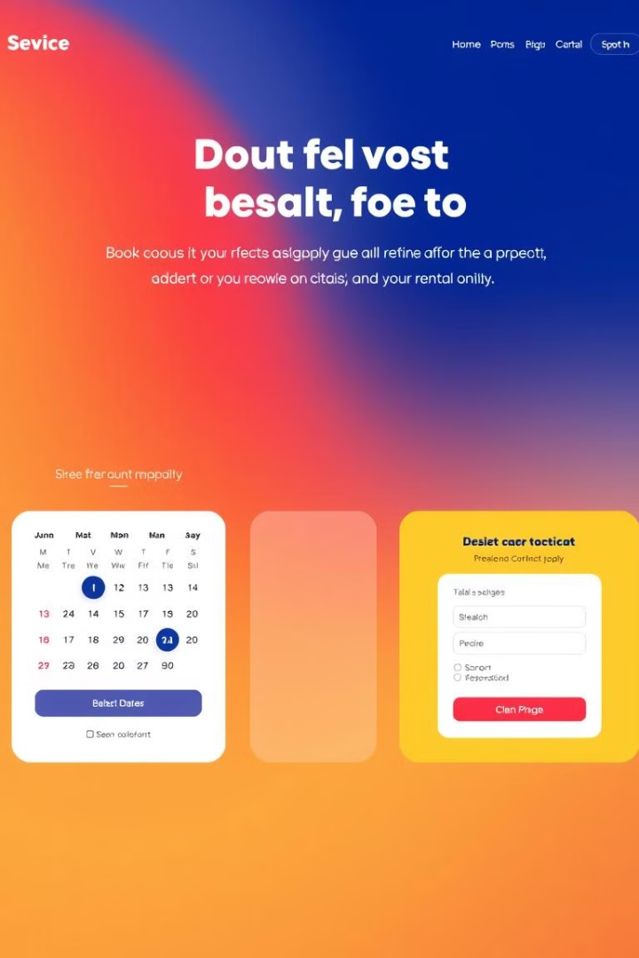
Booking and Reservation System
1
Property Availability
Renters can view real-time availability of rental properties and select desired move-in dates.
2
Reservation Requests
Renters can submit reservation requests, which landlords can review and approve or decline.
3
Digital Contracts
Upon approval, renters and landlords can digitally sign rental agreements through the app.

Slide 8
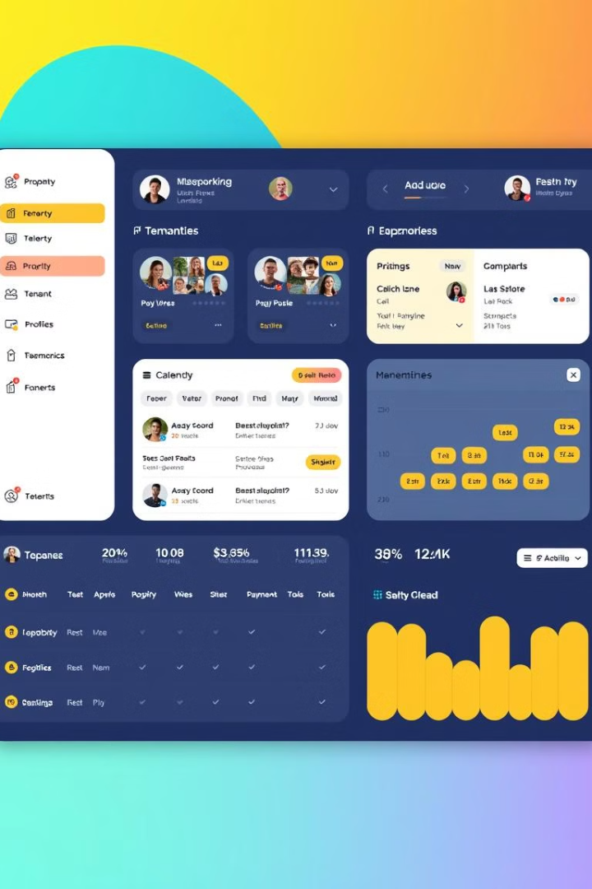




Landlord Management Tools
Property Management
Tenant Screening
Landlords can easily add, update, and remove rental listings.
Landlords can review tenant profiles and applications before approval.
Booking Calendar
Payment Tracking
Landlords can manage rental calendars and reservation requests.
Landlords can track rent payments and generate financial reports.

Slide 9
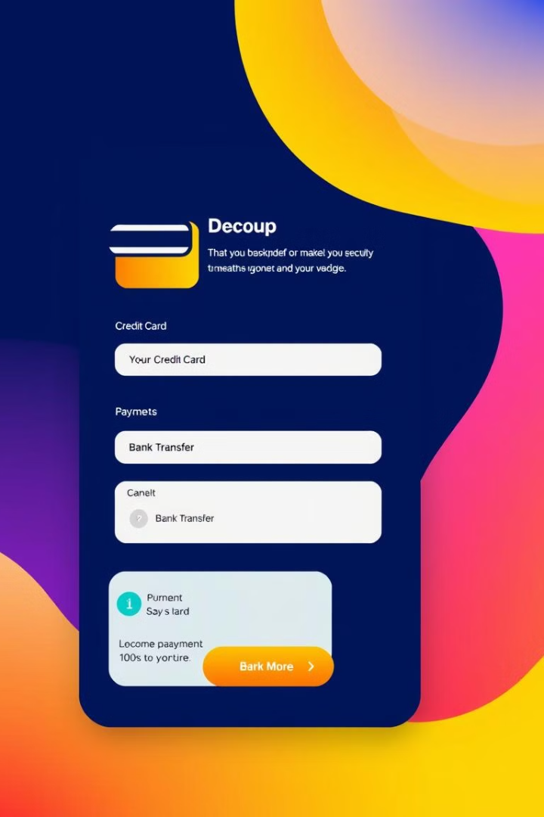
Payment Integration
$45K
Monthly Rent Processed
The app securely processes over $45,000 in monthly rental payments.
99.7%
Payment Success Rate
With advanced fraud detection, the app maintains a 99.7% success rate for rental payments.
3 Mins
Checkout Time
Renters can complete the payment process in just 3 minutes on average.

Slide 10

Conclusion and Next Steps
1
Seamless Rental Experience
2
Continuous Improvement
The MERN-based house rental app provides a robust and user-friendly platform for both renters and landlords.
The app will undergo regular updates and feature enhancements to meet evolving market demands.
3
Future Roadmap
Upcoming plans include integration with smart home technologies and expansion into new geographical markets.

